Slide 1
EUROPEAN TERRITORIAL COOPERATION PROGRAME
GREECE – ITALY 2007 - 2013
Improving governance, management and sustainability of rural and coastal protected areas and contributing to the implementation of the Natura 2000 provisions in IT and GR
BIG –
Dr. Maurizio Pinna,
Researcher of Ecology, University of Salento (Italy).
Email: maurizio.pinna@unisalento.it
Phone: +39/0832298604
Skype: maupinna2008
Kick Off meeting – Corfù, 28 May 2014

Slide 2
EUROPEAN TERRITORIAL COOPERATION PROGRAME
GREECE – ITALY 2007 - 2013
BIG - Partnership
Leader partner (P1) Region of Ionian Islands / Ionian University, Dept. of Informatics
Partner 2 Region of Western Greece
Partner 3 Region of Epirus
Partner 4 Ionian University, Dept. of Informatics
Partner 5 Technological Educational Institute of Epirus
Partner 6 Apulia Region – Parks and Biodiversity Office
Partner 7 Province of Brindisi
Partner 8 University of Salento, Department of Biological and Environmental Sciences and Technologies (DiSTeBA)
Partner 9 Mediterranean Agronomic Institute of Bari (MAIB)

Slide 3
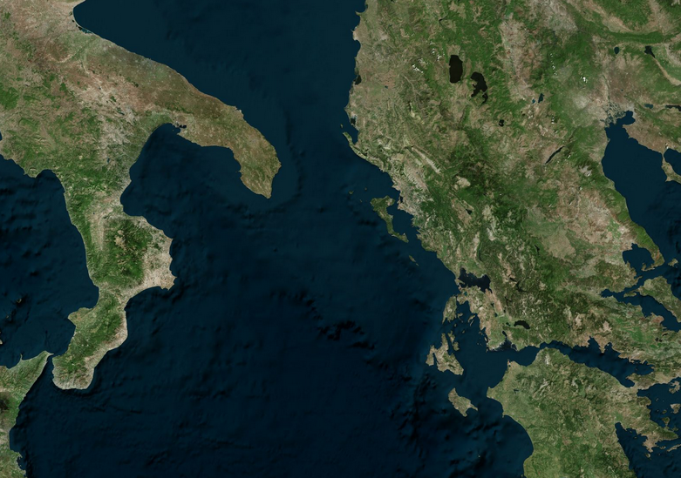
EUROPEAN TERRITORIAL COOPERATION PROGRAME
GREECE – ITALY 2007 - 2013
BIG – Geographical Distribution of Partnership
ITALY
GREECE

Slide 4
Budget: 4.000.000,00€
University of Salento (DiSTeBA) (P8)
Budget: 445.000,00€
Leader partner (P1)
Budget: 540.000,00€
Region of Western Greece (P2) Budget: 575.000,00€
Technological Educational Institute of Epirus (P5)
Budget: 100.000,00€
Apulia Region – Parks and Biodiversity Office (P6) Budget: 450.000,00€
Province of Brindisi (P7)
Budget: 365.000,00€
Region of Epirus (P3)
Budget: 540.000,00€
Ionian University, Dept. of Informatics (P4)
Budget: 320.000,00€
Mediterranean Agronomic Institute of Bari (MAIB) (P9) Budget: 665.000,00€
EUROPEAN TERRITORIAL COOPERATION PROGRAME
GREECE – ITALY 2007 - 2013

Slide 5
Main CHALLENGE
EUROPEAN TERRITORIAL COOPERATION PROGRAME
GREECE – ITALY 2007 - 2013
Providing valuable information for the biodiversity in areas that were not so closely monitored in the past
Helping local and national authorities to make well-informed decisions about protection plans, reserve policies, and future land-use practices
Developing scientific tools for the prediction and prevention of environmental risks
Stimulating citizens to be actively involved in the protection of the environment
Promoting a sustainable model of tourist development in environmental sensitive areas.

Slide 6
EUROPEAN TERRITORIAL COOPERATION PROGRAME
GREECE – ITALY 2007 - 2013
OBJECTIVE OF “BIG”
Improve governance, management and sustainable valorization of coastal and rural protected areas and contributing to the implementation of the Natura 2000 provisions in GR and IT
Strengthening and improving cooperation among regional administrations to further monitor Natura 2000 species and habitats and to set environmental measures for the next programming period. This aims at networking, setting common standards for biodiversity monitoring, creating regional databases and information system, and setting measures based on the updated biodiversity status (also thanks to the link with Lifewatch that enables a wider overview about biodiversity in EU)
Setting cross-border strategies and supporting decision-makers for management and valorization of protected areas and Natura 2000 sites. This includes the definition of guidelines which has already been developed in other projects but needs to be updated and upgraded,the realization and implementation of decision-makers support tools as well as the requalification of managers of protected areas
Developing coordinated concrete actions for the management and valorization of pilot rural and coastal ecosystems, that consists of on-the-ground interventions in Greek and Italian parks and/or Natura 2000 sites
Promoting sustainable tourism in protected areas via networking, implementation of concrete actions and transfer of best practices. This foresees the improvement and animation of existing pedestrian, cycling and local food paths in order to create a GR-IT common route for sustainable tourism in protected areas, the realization of a cross-border portal for touristic promotion, and finally the promotion of best practices about the European Charter of sustainable tourism in protected areas

Slide 7
EUROPEAN TERRITORIAL COOPERATION PROGRAME
GREECE – ITALY 2007 - 2013
Work Package “6” and Activities (n)
WP/ Action Code | WP/ Action Title | Start | End
WP 1 | Management & Coordination | 01/01/2014 | 31/12/2015
Action 1.1 | Preparation Activities | 22/03/2013 | 07/05/2013
Action 1.2 | Project coordination meetings | 01/01/2014 | 31/12/2015
Action 1.3 | Project management and external audit | 01/01/2014 | 31/12/2015
WP 2 | Information & Publicity | 1/01/2014 | 31/12/2015
Action 2.1 | Communication plan | 01/01/2014 | 31/01/2014
Action 2.2 | Publications, Photodocumentaries and Website | 01/01/2014 | 31/12/2015
Action 2.3 | Kick-off and final meeting | 01/01/2014 | 31/12/2015
WP 3 | Strengthening of the regional observatories on biodiversity in Greece and in Italy through the establishment of a network of local authorities | 01/01/2014 | 31/12/2015
Action 3.1 | Creation of a trans-boundary network among regional/local authorities and scientific institutions for the management, governance and valorization of protected areas and setting of priorities and measures of the 2014-2020 programming period | 01/01/2014 | 31/12/2015
Action 3.2 | Defining common standards (protocols) for the monitoring of species and habitats in order to prevent risks and to safeguard and valorize protected areas and sharing and fine-tuning with regional/local stakeholders (local meetings) | 01/01/2014 | 30/06/2014
Action 3.3 | Development of Database and Information System | 01/01/2014 | 31/05/2015

Slide 8
Work Package and Activities
EUROPEAN TERRITORIAL COOPERATION PROGRAME
GREECE – ITALY 2007 - 2013
WP/ Action Code | WP/ Action Title | Start | End
WP 4 | Common trans-boundary strategies for the sustainable management and valorization of natural resources | 01/09/2014 | 31/12/2015
Action 4.1 | Best practises, management and valorization of natural resources | 01/09/2014 | 28/02/2015
Action 4.2 | Realization of a decision-makers support tool for the management, for the assessment and prevention of emerging risks and for suggesting solutions in conflicts in land use, with particular attention to protected areas | 01/01/2015 | 30/06/2015
Action 4.3 | Developing geo-referenced maps about naturalistic values and livestock products origin, their description and producing recommendations on safeguarding and touristic exploitation of the territory. | 01/02/2015 | 31/12/2015
Action 4.4 | Training for the requalification of the professional profile of managers of protected areas | 01/07/2015 | 31/08/2015
WP 5 | Valorization and sustainability of the protected areas through concrete and pilot actions with the involvement of society/general public about coastal and marine ecosystems | 01/07/2014 | 31/12/2015
Action 5.1 | Pilot action about management and valorization of coastal ecosystems in Parco delle Dune Costiere – Brindisi for reducing the dunes erosion (IT-1) | 01/07/2014 | 31/12/2015
Action 5.2 | Pilot action about monitoring and management of cliffs and caves in Parco Otranto – S. Maria Leuca e bosco di Tricase (IT-2) and realization and implementation of a laboratory for coastal and marine biodiversity monitoring | 01/07/2014 | 31/12/2015
Action 5.3 | Pilot action in Greece (GR -1) | 01/07/2014 | 31/12/2015
Action 5.4 | Pilot action in Greece (GR-2) | 01/07/2014 | 31/12/2015
Action 5.5 | Pilot action in Greece (GR-3) | 01/07/2014 | 31/12/2015
WP 6 | Strengthening the sustainable touristic offer of protected areas | 01/06/2014 | 31/12/2015
Action 6.1 | Design, boosting and valorization of new and existing tourist routes | 01/06/2014 | 30/11/2015
Action 6.2 | Cross-border portal for touristic promotion, including the development of an app for smartphones to integrate touristic services and the development and spreading of touristic packages to potentiate touristic flows | 01/11/2014 | 31/12/2015
Action 6.3 | Dissemination and transfer of best practices about the European Charter for sustainable tourism in protected areas | 01/05/2015 | 31/12/2015

Slide 9
EUROPEAN TERRITORIAL COOPERATION PROGRAME
GREECE – ITALY 2007 - 2013
Action - Deliverable
Action | Deliverable Title
1.1 | Preparation of BIG project proposal
1.2 | n. 5 minutes of the project coordination meetings
1.3 | n. 5 progress reports & n. 8 auditing report
2.1 | n. 1 Communication plan and n. 4 six-monthly reports of the coordination of communication activities
2.2 | Brochures, leaflets and posters & Photodocumentary (Ionian Islands) & website; Publication of joint monitoring protocols & Photodocumentary (Western Greece) & website; Photodocumentary (Epirus) & website; Website; Publication of the GR-IT sustainable route & website; Guidelines for the management and valorization of Protected Areas & Photodocumentary (Apulia) & website.
2.3 | Kick-off and final meeting
3.1 | Report about networking on governance, management and valorization of protected areas
3.2 | Joint protocols for monitoring and safeguard species and habitats
3.3 | Database populated & Information System & Information system implemented with regional and international data; Biodiversity database & Information system;

Slide 10
Action - Deliverable
EUROPEAN TERRITORIAL COOPERATION PROGRAME
GREECE – ITALY 2007 - 2013
Action | Deliverable Title
4.1 | List and related sheet of best practices & Guidelines for the management and valorization of protected areas
4.2 | Project of the common decision-makers support tool
4.3 | Geo-referenced maps about the livestock products origin, their description and correspondent recommendations
4.4 | Report of the training course for the requalification of professional profile of managers of protected areas
5.2 | Report of the implementation of the pilot action in IT (1) (2)
5.3 | Pilot action in Greece (GR -1)
5.4 | Report of the implementation of the pilot action in GR (2)
5.5 | Report of the implementation of the pilot action in GR (3)
6.1 | Report of the design of the GR-IT sustainable touristic route & Report of the requalification of existing paths (Ionian Islands; Western Greece; Epirus) & Report of animation;
6.2 | Report of cross-border sustainable tourism improvement; Software development and report for cross-border sustainable tourism improvement;
6.3 | Report of the dissemination of best practices about the European Charter on sustainable Tourism
6.3 | Report of the dissemination of best practices about the European Charter on sustainable Tourism

Slide 11
MAIN ACTIVITIES
EUROPEAN TERRITORIAL COOPERATION PROGRAME
GREECE – ITALY 2007 - 2013
(WP3) defining common monitoring standards as well as the realization of a biodiversity information system
(WP5) realization of concrete and pilot action in GR and in IT
(WP6) realization of a sustainable GR-IT touristic route and the development of a cross-border portal
(WP4) updating guidelines for management of protected areas, realization and implementation of decision-makers support tool and training for managers of protected areas

Slide 12
MAIN EXPECTED OUTPUTS
EUROPEAN TERRITORIAL COOPERATION PROGRAME
GREECE – ITALY 2007 - 2013
Realization and/or implementation of the regional observatories and related n. 1 common system for the biodiversity monitoring (WP3)
n. information 1 strategies/guidelines and n.1 decision-makers support system for the management and valorization of protected areas (WP4)
n. 5 pilot projects for the sustainable management and valorization of protected areas (WP5)
Design of a Greece-Italy touristic route for the valorization of protected areas and Natura 2000 sites and n. 1 cross-border portal for touristic promotion (WP6)

Slide 13
TARGET GROUPS
EUROPEAN TERRITORIAL COOPERATION PROGRAME
GREECE – ITALY 2007 - 2013
Regional administrations and local entities, that need a coordination for monitoring and answering to global climate changes
Parks managing authorities, which need innovative tools to manage biodiversity in a coordinated way
Visitors of protected and Natura 2000 areas and local populations/citizens, that will be involved for defining the proper valorization strategies and that benefits of the concrete interventions in protected areas
Tourists in general, that need an integrated approach to make the best use of the available resources (both naturalistic values and services)
Tourism enterprises (especially SMEs), that need to address the lack of coordination among them and valorization tools 5. tourists in general, that need an integrated approach to make the best use of the available resources

Slide 14
Thank you!
EUROPEAN TERRITORIAL COOPERATION PROGRAME
GREECE – ITALY 2007 - 2013

